Slide 1



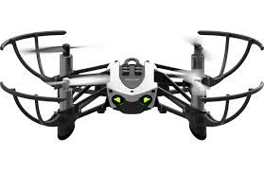

HackAU 2018
Ariel University’s
First ever hackathon

Slide 2
The world
In the reality that we live in today, Drones becomes more and more accessible.
If you have 10$ you could get a small drone. For a price of 50$ you could get a bigger drone with a camera so you could get a live video stream while flying around.
If you could add 50-100$ you could even get a drone with the ability to go higher and further.
This accessibility brings with it also the problem of “rogue” drone pilots.

Slide 3
Problem
Lets imagine the next scenario:
A drone from a hostile country has entered Israel through the skies. We can assume that the drone have a camera connected to a screen in the hostile country. Although IDF bases are very protected, a drone could fly for a minute or two before the drone will be shut down. How much data could the drone give to its user only from a minute of a recorded video?
If you don't know the answer then a lot!

Slide 4
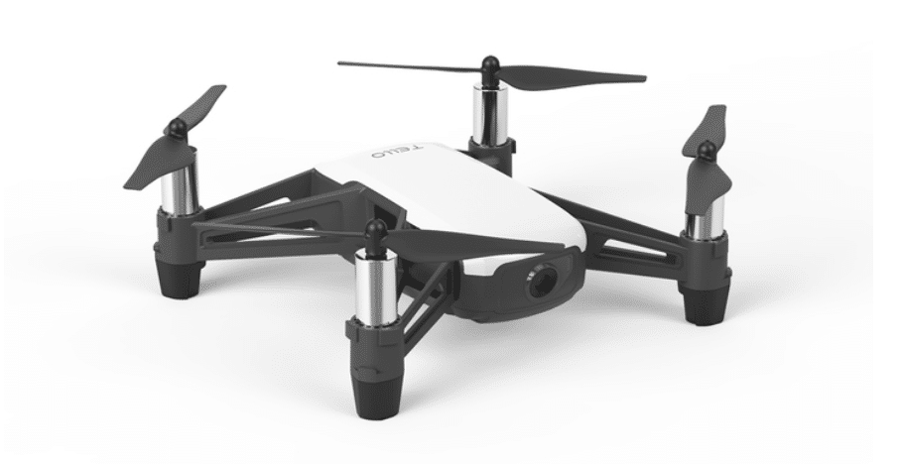
Solution
The Israeli IDF already have a way to shut down the hostile drones but they have to be in the field.
Our solution doesn’t require a team to be on the field.
By using small drones that are already in the field we can destroy the threat.
Suicide Drone

Slide 5
Business Model
At the beginning we need to powerup our sensors for better and faster resulst to fix our program and then we will sell it to protect places that are most of the time under attack and to save pepole from the hostile drone that renewed all time long.
Our product can also be uses in the future like a house guard that finds risks and tell you about it.

Slide 6



Market Adoption As we believe, we think that our product will be sold widely across companies that work in the area of the army industry because our product is chip and doesn’t need a team on the field.

Slide 7
Competition Our competition is everything which is used to take out hostile drones, missiles and planes with out pilot. For examples: 1. Iron Dome 2. Anti-aircraft missiles and more…

Slide 8
Team Aviv Mishiner – Team leader Evyatar Agay Noam Tsfati Itay Frank

Slide 9
Thank you for listening

Slide 10
The presentation should have the following slides:
The World
Problem
Solution
Business Model
Market Adoption
compatition
Team
POC

